Slide 1
Amazon Fresh Analytics

Slide 2
TASK - 1
ER diagram

Slide 3
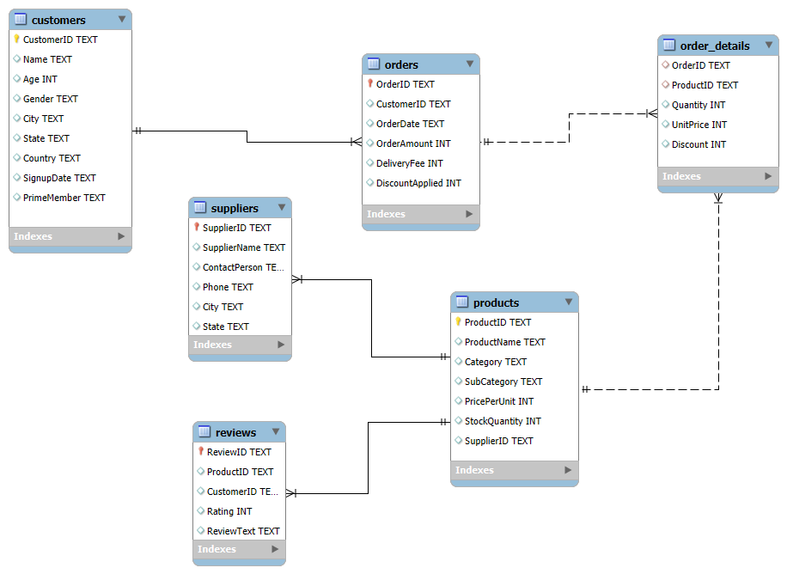

Slide 4
TASK - 2
Identifying the primary keys and foreign keys

Slide 5
Customers Table
Primary Key: CustomerID (TEXT)
Foreign Keys: None
Relationships:
One-to-many with Orders (1 customer can place many orders)
One-to-many with Reviews (1 customer can write many reviews)

Slide 6
Orders Table
Primary Key: OrderID (TEXT)
Foreign Keys:
CustomerID (references Customers.CustomerID)
Relationships:
Many-to-one with Customers (many orders belong to 1 customer)
One-to-many with Order_Details (1 order contains many items)

Slide 7
Products Table
Primary Key: ProductID (TEXT)
Foreign Keys:
SupplierID (references Suppliers.SupplierID)
Relationships:
Many-to-one with Suppliers (many products supplied by 1 supplier)
One-to-many with Order_Details (1 product can appear in many orders)
One-to-many with Reviews (1 product can have many reviews)

Slide 8
Suppliers Table
Primary Key: SupplierID (TEXT)
Foreign Keys: None
Relationships:
One-to-many with Products (1 supplier provides many products)

Slide 9
Reviews Table
Primary Key: ReviewID (TEXT)
Foreign Keys:
ProductID (references Products.ProductID)
CustomerID (references Customers.CustomerID)
Relationships:
Many-to-one with Products (many reviews about 1 product)
Many-to-one with Customers (many reviews written by 1 customer)

Slide 10
Order_Details Table
Primary Key: Composite of OrderID + ProductID or OrderDetailID
Foreign Keys:
OrderID (references Orders.OrderID)
ProductID (references Products.ProductID)
Relationships:
Many-to-one with Orders (many items belong to 1 order)
Many-to-one with Products (many order items can reference 1 product)

Slide 11
Task - 3

Slide 12
1. All customers from a specific city.
SELECT
CustomerID,
Name,
Age,
Gender,
City,
State,
Country,
SignupDate,
PrimeMember
FROM Customers
WHERE City = 'Lake Brianna'

Slide 13
2. All products under the "Fruits" category.
SELECT ProductName,
Category,
SubCategory,
PricePerUnit,
StockQuantity,
SupplierID
FROM Products
WHERE category = 'Fruits';

Slide 14
Task - 4

Slide 15
CustomerID as the primary key.
Age cannot be null and must be greater than 18.
unique constraint for Name.
CREATE table customers_demo(
customerID VARCHAR(200) PRIMARY KEY,
Name VARCHAR(200) UNIQUE,
Age INT NOT NULL CHECK(Age >= 18),
Gender VARCHAR(10),
City VARCHAR(10),
State VARCHAR(10),
Country VARCHAR(10) DEFAULT 'India',
SignupDate DATE,
PrimeMember ENUM('YES', 'NO') NOT NULL DEFAULT 'NO’
);

Slide 16
Task - 5

Slide 17
Insert 3 new rows into the Products table
INSERT INTO Products (productID,ProductName,Category,SubCategory,PricePerUnit,StockQuantiy,SupplierID)
VALUES
('PROD1001', 'Organic Apples', 'Fruits', 'Apples', 2.99, 500, 'SUP001'),
('PROD1002', 'Whole Bread', 'Bakery', 'Bread', 3.49, 300, 'SUP002'),
('PROD1003', 'Free Eggs (12pk)', 'Dairy', 'Eggs', 4.99, 200, 'SUP003');
DELETE FROM Products WHERE ProductID IN ('PROD1001', 'PROD1002', 'PROD1003');

Slide 18
Task - 6

Slide 19
Update the stock quantity of a product where ProductID matches a specific ID.
UPDATE Products
SET StockQuantity = 250
WHERE ProductID = 'PROD1001';

Slide 20
Task - 7

Slide 21
Delete a supplier from the Suppliers table where their city matches a specific value.
DELETE FROM suppliername
WHERE city = 'Schneidermouth';

Slide 22
Task - 8

Slide 23
Add a CHECK constraint to ensure that ratings in the Reviews table are between 1 and 5.
ALTER TABLE Reviews
ADD CONSTRAINT check_rating
CHECK (Rating BETWEEN 1 AND 5);
To check
INSERT INTO reviews(Rating)
VALUES(0);
The second task I have finished in the customer table(task - 4)

Slide 24
Task - 9

Slide 25
1. WHERE clause to find orders placed after 2024-01-01.
SELECT *
FROM orders
WHERE OrderDate >='2024-01-01';

Slide 26
2. HAVING clause to list products with average ratings greater than 4.
JOIN
reviews r ON p.ProductID = r.ProductID
GROUP BY
p.ProductID,
p.ProductName,
p.Category,
p.SubCategory,
p.PricePerUnit,
p.StockQuantity
HAVING
AVG(r.Rating) > 4
ORDER BY average_rating DESC,
total_reviews DESC;
SELECT
p.ProductName,
p.Category,
p.SubCategory,
p.PricePerUnit,
p.StockQuantity,
COUNT(r.ReviewID) AS total_reviews,
ROUND(AVG(r.Rating), 2) AS average_rating
FROM
products p

Slide 27
3.GROUP BY and ORDER BY clauses to rank products by total sales.
SELECT
p.productid,
p.productname,
p.category,
sum(od.quantity) as total_unit_sold,
SUM(od.quantity * od.unitprice) AS total_revenue,
COUNT(DISTINCT o.orderid) AS order_count,
ROUND(SUM(od.quantity * od.unitprice) / SUM(od.quantity), 2) AS average_price_per_unit
FROM
products p
JOIN
order_details od ON p.ProductID = od.ProductID
JOIN
orders o ON od.OrderID = o.OrderID
GROUP BY
p.ProductID,
p.ProductName,
p.category,
p.PricePerUnit
ORDER BY
total_unit_sold DESC,
total_revenue DESC;

Slide 28
3.GROUP BY and ORDER BY clauses to rank products by total sales.
SELECT
p.ProductID,
p.ProductName,
SUM(od.Quantity * od.UnitPrice) AS TotalSales,
RANK() OVER (ORDER BY SUM(od.Quantity * od.UnitPrice) DESC) AS SalesRank
FROM
Products p
JOIN
Order_Details od ON p.ProductID = od.ProductID
GROUP BY
p.ProductID,
p.ProductName
ORDER BY
TotalSales DESC;

Slide 29
Task - 10

Slide 30
1.Calculate each customer's total spending.
SELECT
c.customerid,
c.name,
c.primemember, SUM(o.orderAmount + o.deliveryFee - COALESCE(o.discountApplied, 0)) AS total_spent,
COUNT(DISTINCT o.orderID) AS total_orders
FROM
customers c
JOIN
orders o ON c.customerid = o.customerid
GROUP BY
c.customerid,
c.name,
c.primemember
ORDER BY
total_spent DESC;

Slide 31
2.Rank customers based on their spending.
GROUP BY
c.customerid,
c.name,
c.primemember)
SELECT
customerid,
name,
primemember,
total_spent,
RANK() OVER (ORDER BY total_spent DESC) AS spending_rank
FROM
customer_spending;
WITH customer_spending AS (
SELECT
c.customerid,
c.name,
c.primemember,
SUM(o.orderAmount + o.deliveryFee - COALESCE(o.discountApplied, 0)) AS total_spent
FROM
customers c
JOIN
orders o ON c.customerid = o.customerid

Slide 32
3.Identify customers who have spent more than ₹5,000.
3. WITH customer_spending AS (
SELECT
c.customerid,
c.name,
c.primemember,
SUM(o.orderAmount + o.deliveryFee - COALESCE(o.discountApplied, 0)) AS total_spent,
COUNT(DISTINCT o.orderID) AS total_orders
FROM
customers c
JOIN
orders o ON c.customerid = o.customerid
GROUP BY
c.customerid,
c.name,
c.primemember)
SELECT
customerid,
name,
primemember,
total_spent,
total_orders,
RANK() OVER (ORDER BY total_spent DESC) AS rank_by_spending
FROM
customer_spending
WHERE
total_spent > 5000
ORDER BY
rank_by_spending;

Slide 33
Task - 11

Slide 34
1.Join the orders and orders_details tables to calculate total revenue per order.
select
o.orderID,
o.customerID,
SUM(od.quantity * od.unitprice) AS total_revenue,
COUNT(od.OrderID) AS per_order
from
orders o
join
order_details od on o.OrderID = od.OrderID
GROUP BY
o.orderID,
o.customerID
ORDER BY
total_revenue DESC;

Slide 35
2.Identify customers who placed the most orders in a specific time period.
select
o.orderID,
o.customerID,
SUM(od.quantity * od.unitprice) AS total_revenue,
COUNT(od.OrderID) AS per_order,
MIN(o.orderDate) AS first_order_date,
MAX(o.orderDate) AS last_order_date
from
orders o
join
order_details od on o.OrderID = od.OrderID
GROUP BY
o.orderID,
o.customerID
ORDER BY
total_revenue DESC;

Slide 36
3.Find the supplier with the most products in stock.
SELECT
SupplierID,
SUM(StockQuantity) AS TotalStock
FROM
Products
GROUP BY
SupplierID
ORDER BY
TotalStock DESC
LIMIT 10;
- To check the supplier name
SELECT *
FROM amazon.suppliers
WHERE supplierid = '898ca408-050f-49be-b083-00eedf4bd064';

Slide 37
Task - 12

Slide 38
Separate product categories and subcategories into a new table.
CREATE TABLE Categories (
CategoryID INT PRIMARY KEY AUTO_INCREMENT,
CategoryName VARCHAR(100) NOT NULL,
SubCategoryName VARCHAR(100) NOT NULL
);

Slide 39
INSERT INTO Categories (CategoryName, SubCategoryName)
SELECT DISTINCT Category, SubCategory FROM Products;
UPDATE Products p
JOIN Categories c ON p.Category = c.CategoryName AND p.SubCategory = c.SubCategoryName
SET p.CategoryID = c.CategoryID;
ALTER TABLE Products
DROP COLUMN Category,
DROP COLUMN SubCategory;

Slide 40
Create foreign keys to maintain relationships.
2. ALTER TABLE Products
ADD CONSTRAINT fk_category
FOREIGN KEY (CategoryID)
REFERENCES Categories(CategoryID)
ON DELETE CASCADE
ON UPDATE CASCADE;

Slide 41
Task - 13

Slide 42
1. Identify the top 3 products based on sales revenue.
SELECT
productid,
ProductName,
total_revenue
FROM (
SELECT p.productid,
p.ProductName,
SUM(od.unitprice * od.quantity) AS total_revenue, RANK() OVER (ORDER BY SUM(od.unitprice * od.quantity) DESC) AS revenue_rank
FROM
order_details od
JOIN
products p ON od.productID = p.ProductID
GROUP BY
p.productid, p.ProductName) AS ranked_products
WHERE revenue_rank <= 3;

Slide 43
2. Find customers who haven’t placed any orders yet.
SELECT
customerid,
name
FROM
customers
WHERE customerid NOT IN (
SELECT DISTINCT customerid FROM orders
);

Slide 44
Task - 14

Slide 45
1. Which cities have the highest concentration of Prime members?
SELECT
city,
COUNT(customerid) AS prime_members_count
FROM
customers
WHERE PrimeMember = 'yes'
GROUP BY
city
ORDER BY
prime_members_count DESC;

Slide 46
2.What are the top 3 most frequently ordered categories?
SELECT
c.categoryid,
c.categoryname,
COUNT(od.orderid) AS order_count
FROM
order_details od
JOIN
categories c ON od.productid = c.CategoryID
GROUP BY
c.CategoryID,
c.categoryname
ORDER BY
order_count DESC
LIMIT 3;

